Slide 1

ADAPTIVE REINFORCEMENT LEARNING FOR STOCK MARKET DESICIONS
G. Charan Kumar | K. Sathvik | G. Manish Reddy
Dept. of CSE (AI & ML) — Dayananda Sagar University
Academic Year 2025–2026

Slide 2
What Motivated Us?
⚠️ Social Media Traps
📉 Pump & Dump Schemes
Retail investors are misled by influencers on YouTube, Instagram and Telegram promoting stocks with unrealistic price targets.
Small-cap stocks are heavily promoted, attracting investors before sudden sell-offs cause massive crashes and losses.
🔍 Incomplete Platforms
💡 Personal Experience
Existing tools focus only on technical charts and don't combine sentiment, news, or market-regime context.
Direct exposure to market traps motivated building a multi-factor cross-verification system for retail investors.

Slide 3
Introduction
The Indian stock market (NSE Nifty 50) is one of the fastest-growing equity markets in Asia. With increasing retail participation and social-media-driven decisions, there is an urgent need for intelligent, transparent advisory systems. Most existing platforms provide only technical indicators and fail to combine sentiment analysis or market-regime conditions.
Technical Analysis
Sentiment Analysis
Market Regime
10 indicators → composite
Technical Strength Score (0–100)
FINBERT on Finnhub &
NewsAPI real-time headlines
Gaussian HMM on Nifty 50
log-returns (Bull / Bear / Sideways)
→ PPO Agent → BUY / HOLD / SELL

Slide 4
Problem Statement
01
Retail Investor Vulnerability —
Decisions based on social media tips and paid influencers rather than proper market analysis.
02
Sentiment Blindness —
Existing tools ignore financial news entirely — dangerous when company announcements drive sharp moves.
03
Regime Unawareness —
No retail tool for India integrates a formal market-regime classifier. Even strong stocks fall in bear markets.
04
No Unified Platform —
Technical strength, sentiment, regime analysis and news explanations are never combined in one system.

Slide 5
Proposed Solution
Cross-verification system — not a direct financial advisor — helping investors validate stock suggestions from social media before committing capital.
📊 Technical Score (0–100)
📰 Sentiment Score (0–100)
🌐 Market Regime
10 indicators normalised to a composite strength score.
FINBERT NLP on live Finnhub + NewsAPI headlines.
HMM classifies Nifty 50 as Bullish / Sideways / Bearish.
🤖 PPO RL Agent
🔎AI Explainability Assistant
📋 BUY / HOLD / SELL Signal
Trained on 7 years of NSE data; 24-dim state vector.
Chatbot explains why a stock is marked BUY, HOLD, or SELL.
Final action from PPO policy with full justification.

Slide 6

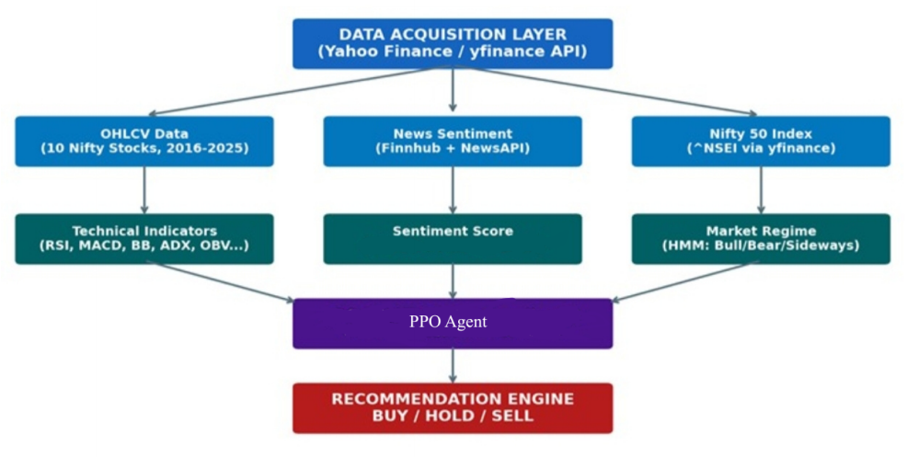
System Architecture

Slide 7
Methodology — Model Workflow
Data
Gathering
Technical
Indicators
Sentiment
Analysis
HMM Regime
Detection
State Vector
Construction
yfinance / Finnhub
/ NewsAPI
RSI, MACD, BB,
ADX, OBV…
FINBERT on
headlines
3-state Gaussian
HMM on Nifty 50
24-dim
standardised
PPO Agent (Stable-Baselines3)
Signal Generation & Output
Training: Jan 2016 – Dec 2023 (500k timesteps)
Validation: 2024 | Test: Jan 2025 – Apr 2026
Action Space: Continuous Box(−1, +1)
🟢 BUY (action > 0.3)
🟡 HOLD (−0.3 to 0.3)
🔴 SELL (action < −0.3)

Slide 8
Technology Stack
Data & APIs
ML & RL
Technical Analysis
Infrastructure
◆ yfinance (Yahoo Finance)
◆ Stable-Baselines3 (PPO)
◆ ta (Python TA library)
◆ Python 3.10+
◆ Finnhub API
◆ hmmlearn (Gaussian HMM)
◆ RSI, MACD, BB, ADX
◆ Pandas / NumPy
◆ NewsAPI
◆ scikit-learn (scaling)
◆ OBV, Stochastic, ROC
◆ Matplotlib / Seaborn
◆ Nifty 50 (^NSEI)
◆ FINBERT Sentiment
◆ ATR, EMA, SMA
◆ CSV caching layer

Slide 9
Results and Discussion
1.01
+9.13%
64/100
Technical Score
(KOTAKBANK – moderate positive)
48/100
50/100
Sharpe Ratio
(KOTAKBANK )
Cumulative Return
(KOTAKBANK test period)
Regime Score
(Bullish macro context)
Sentiment Score
(KOTAKBANK – moderate positive)
Consolidated PPO Signals — All 10 Nifty 50 Stocks
Stock | Company | Signal | Sharpe | Cum. Return
TCS.NS | Tata Consultancy | SELL | -1.55 | -11.98%
RELIANCE.NS | Reliance Industries | HOLD | 0.50 | +5.86%
HDFCBANK.NS | HDFC Bank | BUY | -0.53 | -8.46%
KOTAKBANK.NS | Kotak Mahindra | SELL | 1.01 | +9.13%
ITC.NS | ITC | BUY | 0.42 | +4.87%

Slide 10
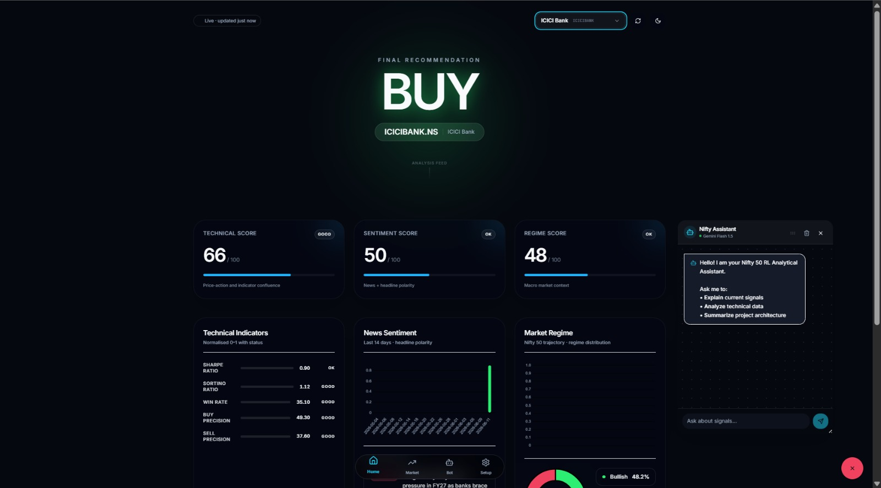
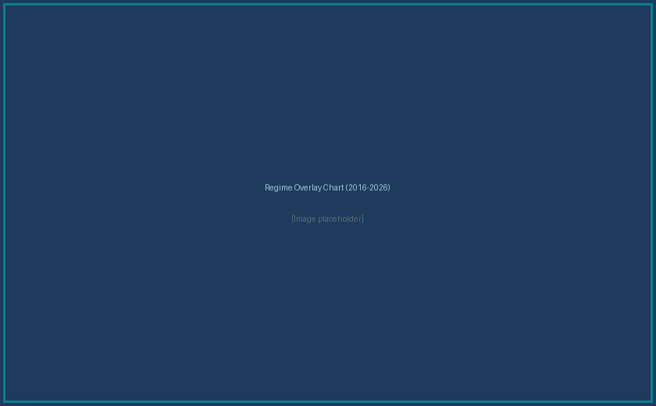
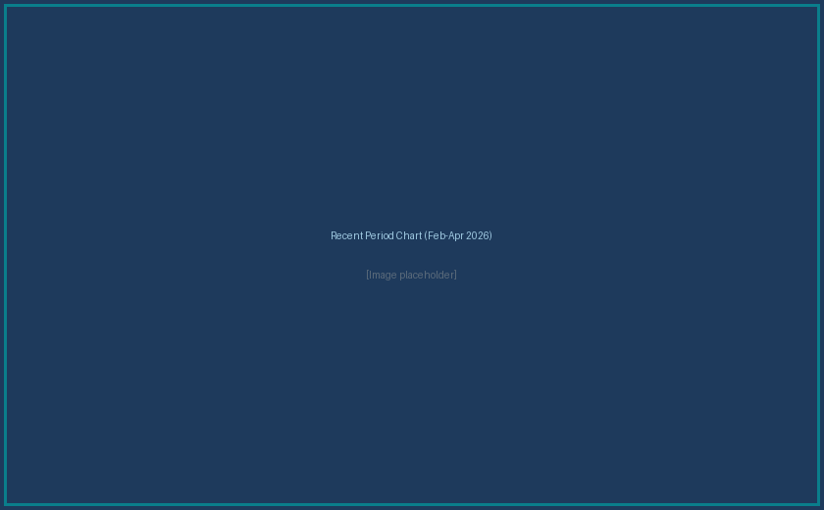
Dashboard
Regime Distribution (2016–2026)
Bullish 28.6%
Long-term structural growth
Sideways 68.3%
Consolidation phases dominate
Bearish 3.0%
COVID crash (Mar–May 2020)
Regime Score 91.5 / 100 reinforces BUY signals for technically strong stocks
HMM correctly identified COVID-19 crash as Bearish regime in March 2020

Slide 11
Applications
01
02
03
Retail Investor Protection
Signal Cross-Verification
Market Regime Monitoring
Cross-verify social-media stock tips before committing capital.
Validate buy/sell suggestions with multi-dimensional evidence.
Track macro conditions (Bull / Sideways / Bear) for portfolio positioning.
04
05
06
Explainable AI in Finance
Index Screening
Live Paper Trading
Per-indicator breakdowns foster transparency and trust in AI decisions.
Scale to all 50 Nifty stocks for institutional-grade sector rotation.
Integrate with Kite Connect API for real-time signal execution.

Slide 12
Forth Comings — Future Work
Scale to All Nifty 50
Risk Analysis Module
AMORS FRAMEWORK
Portfolio Optimisation

Slide 13
THANK YOU.
DEMO BEGINS.
AMORS — Reinforcement Learning with Regime Detection for Stock Signal Generation
Dayananda Sagar University, Dept. of CSE (AI & ML) | 2025–2026

